Slide 1

Tony Ratliff
J’lesa Carr
Trayvon McKnight

Slide 2
Project Name: Study Buddy
Project Goal: To provide a better communication system for students
Project Description:
Eliminate face to face interaction
Find those who are willing to share notes
Join a specific class chatroom
Ability to speak publicly
Ability to speak privately
ability to view images containing notes

Slide 3
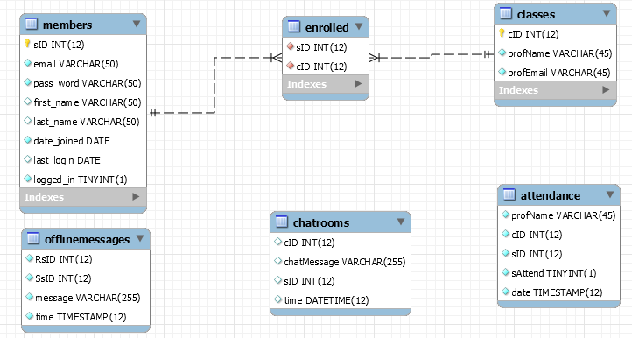

Slide 4
Client / Server Communication Requirements
Chat hub to handle multiple communications.
Let user know when the server is unavailable.
Allow a user to create a new account.
User authentication for logging into the chat hub.
Assigning students to the correct class.
Saving chat room messages for offline users.
Ability to see who is logged into the chat hub.
Notifications of student and server messages.
Ability to send and receive files.
Secure all data across the internet.

Slide 5
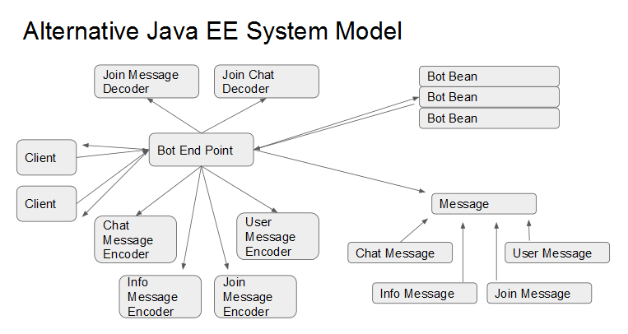
Client / Server Model
Alternative Model

Slide 6
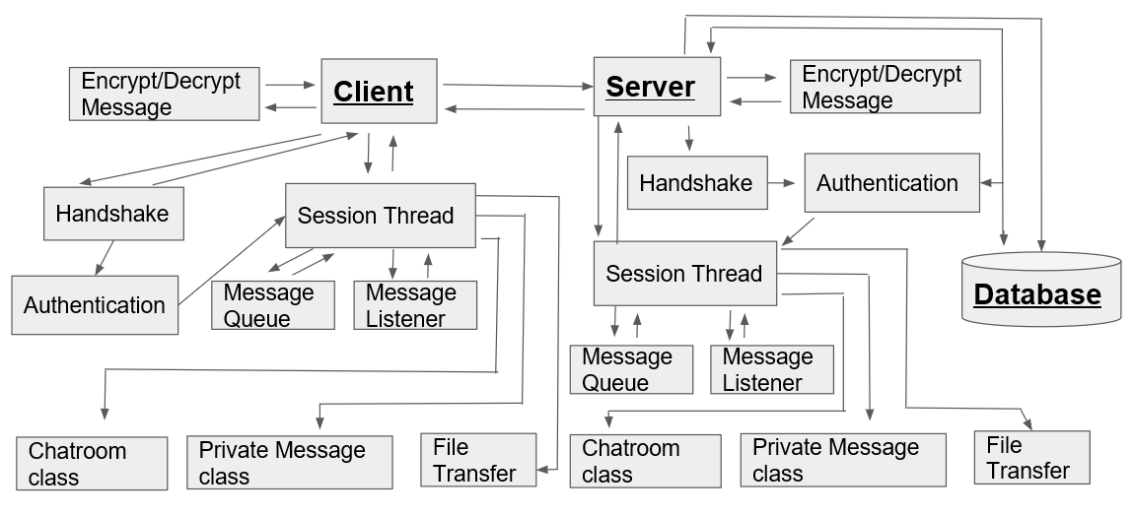
Client / Server Model
Selected Model:

Slide 7
Client / Server Handshake Protocol
CLIENT
SERVER
Diffie-Hellman Elliptic Curve
AES 128 - CBC
HMAC - SHA 256
Key Exchange Symmetric Cipher
HANDSHAKE
HANDSHAKE
05:HANDSHAKE:STUDYBUDDY:1.20:::01

Slide 8
Client / Server Login
Login Responses:
No User
Incorrect Password
Handshake First
Login Accepted
New Account Responses:
Email Exists
Bad Password Format
New Account Accepted
CLIENT
SERVER
AUTHENTICATION
AUTHENTICATION
Login
New Account
Login
New Account
01:LOGIN:<email>:<password>:::01
09:CREATEACCOUNT:<email>:<pass>:<fname>:<lname>:01

Slide 9
Client / Server Sessions
Message Queue:
Linked Blocking Queue
Processes Commands
Separate Thread
Message Listener:
Decrypts Messages
Puts messages on queue.
Separate Thread
CLIENT
SERVER
SESSION
SESSION
Message Queue
Message Listener
Message Queue
Message Listener
04:CHANGEPASS:<oldpass>:<newpass>:::01
04:CHANGEPASS:<oldpass>:<newpass>:00:SUCCESS:00

Slide 10
Client / Server Cross Session Communications
Client
Session
Session
Client
Client
Session
Session
Client

Slide 11
Client / Server Chat Room Data Structure
Chat Rooms
Chat Room
Chat Room
Chat Room
Students
Students
Students
Messages
Files
Messages
Files
Messages
Files

Slide 12
Client / Server Code
Server Side:
9 Different Classes
3 Different Packages
2,415 Lines of Code
Compiled to Jar File
IBM Compatible Computer
Ubuntu Server 16.04
Core i7 3.00 GHZ
16 GB Ram
500 GB Drive
Client Side:
5 Different Classes
3 Different Packages
1,222 Lines of Code
Compiled with Android Studio
Android Device Kit Kat (api 19)

Slide 13
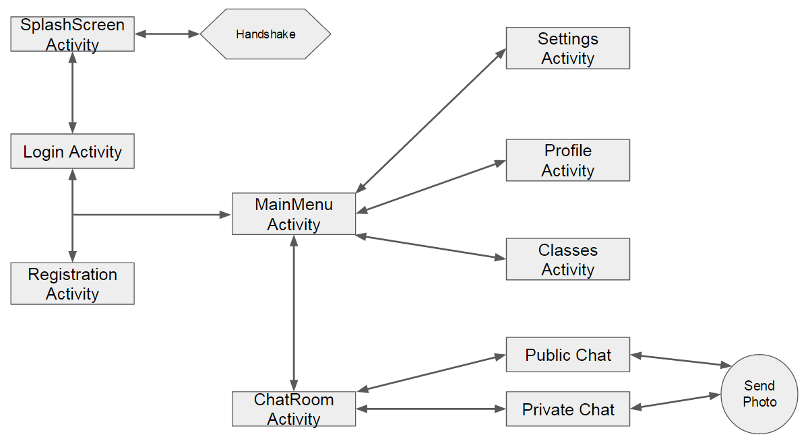
User Interface

Slide 14
Demonstration

Slide 15
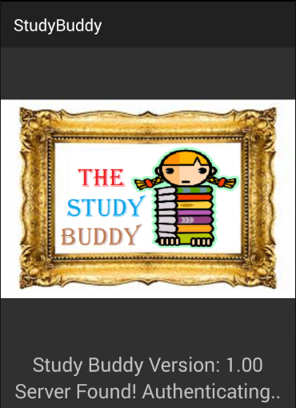
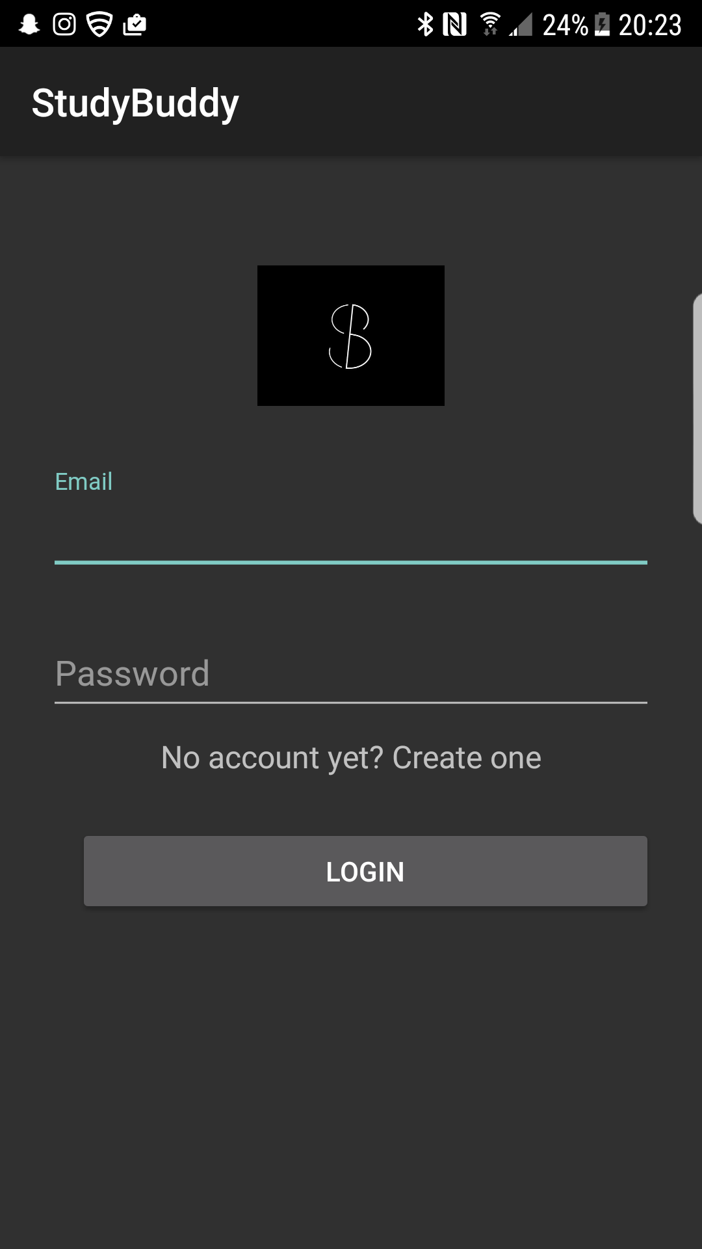

Slide 16
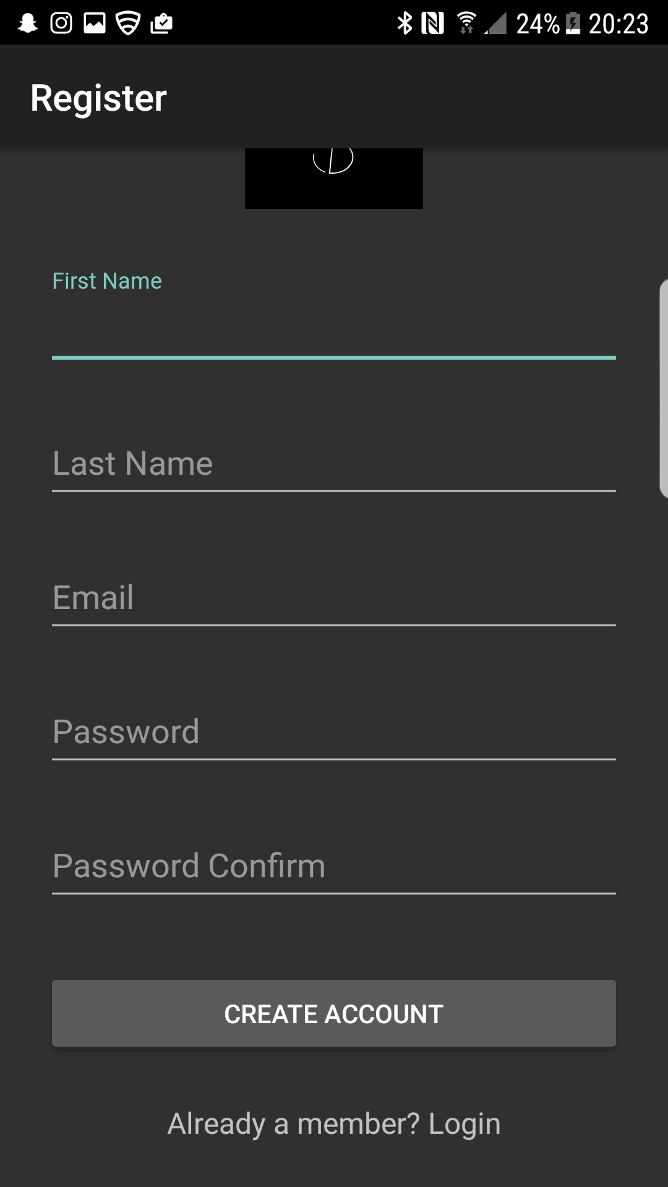
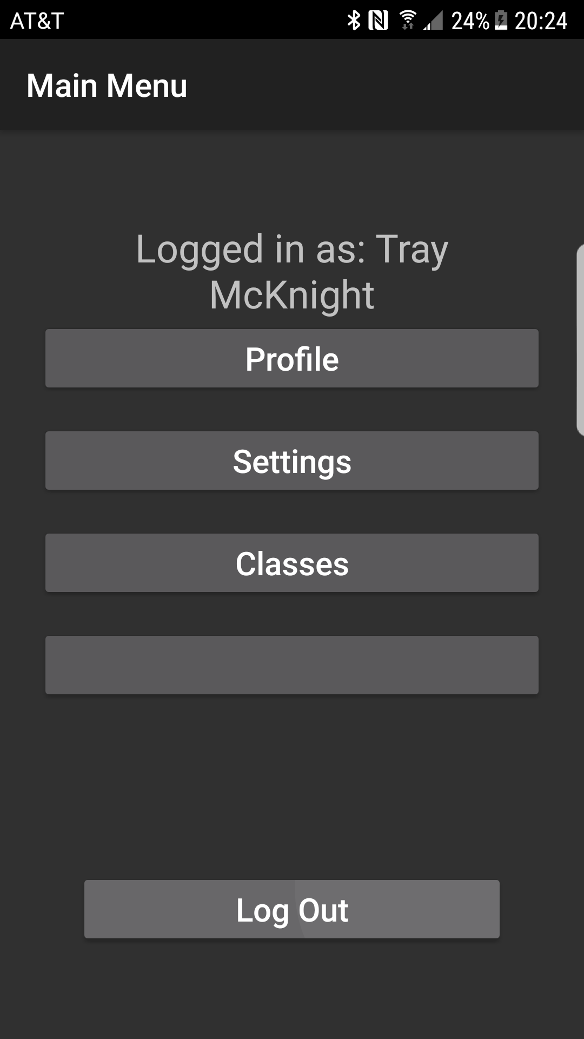

Slide 17
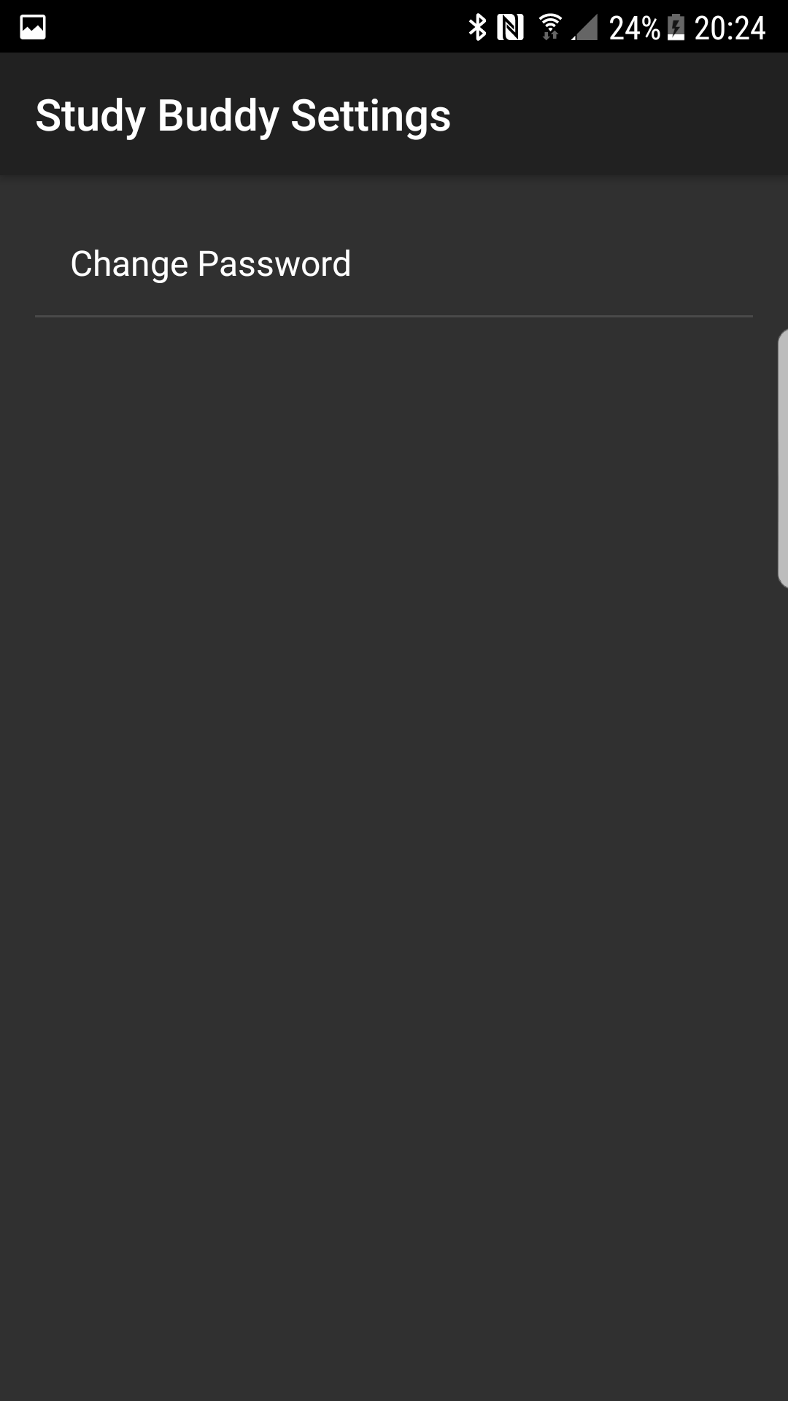
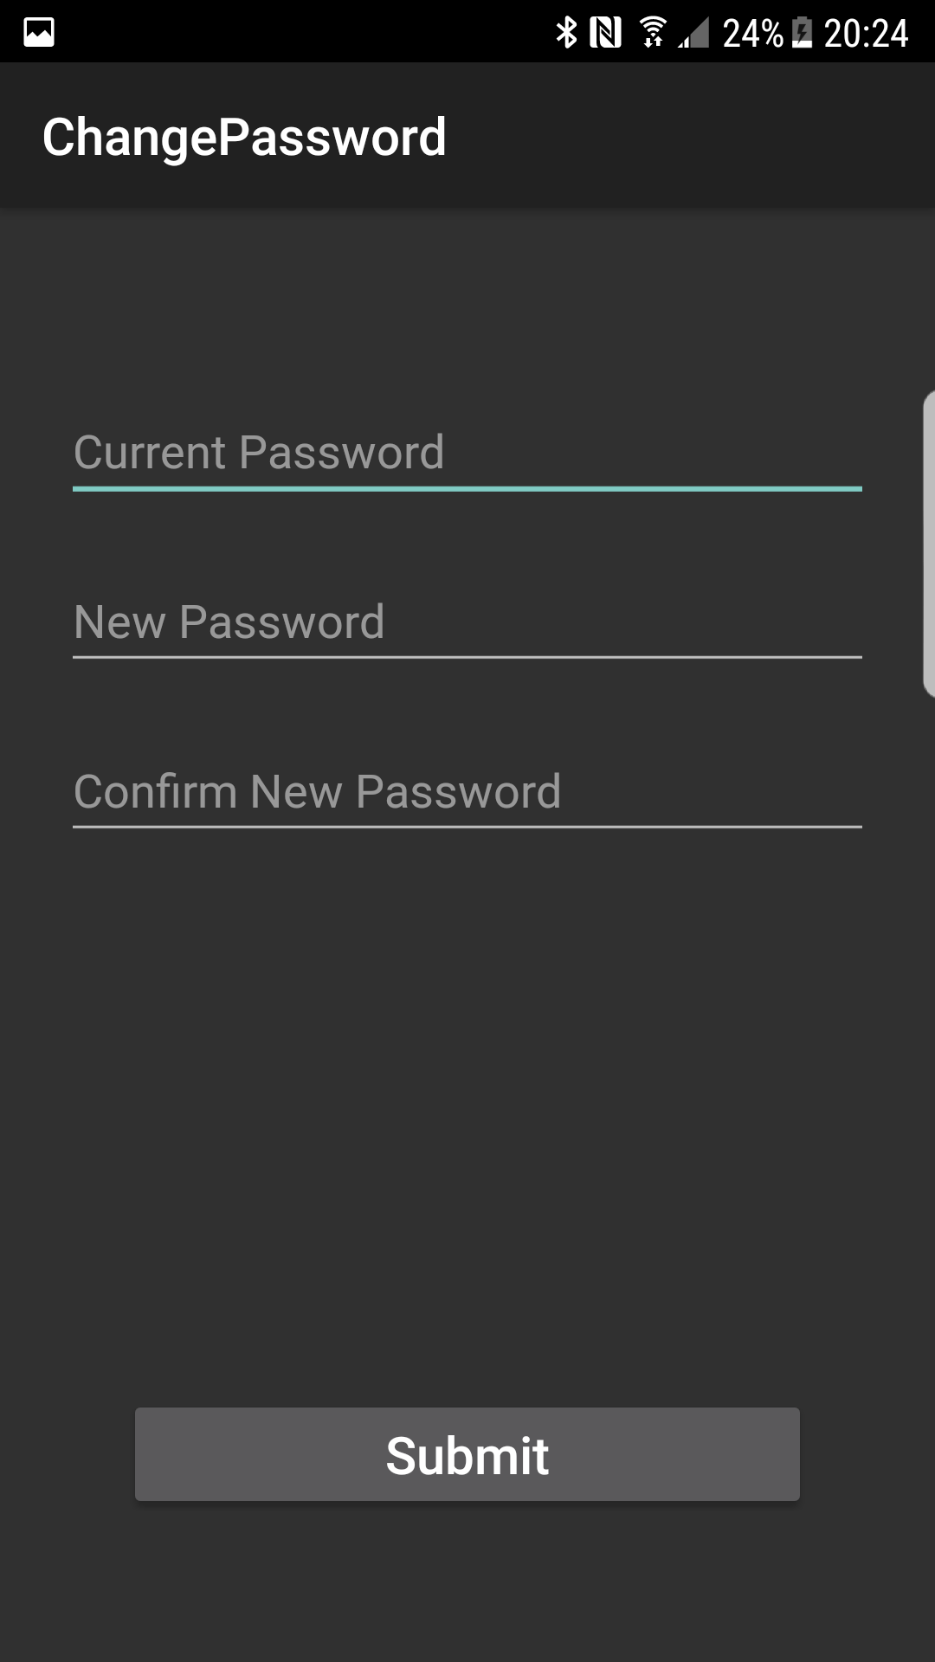

Slide 18
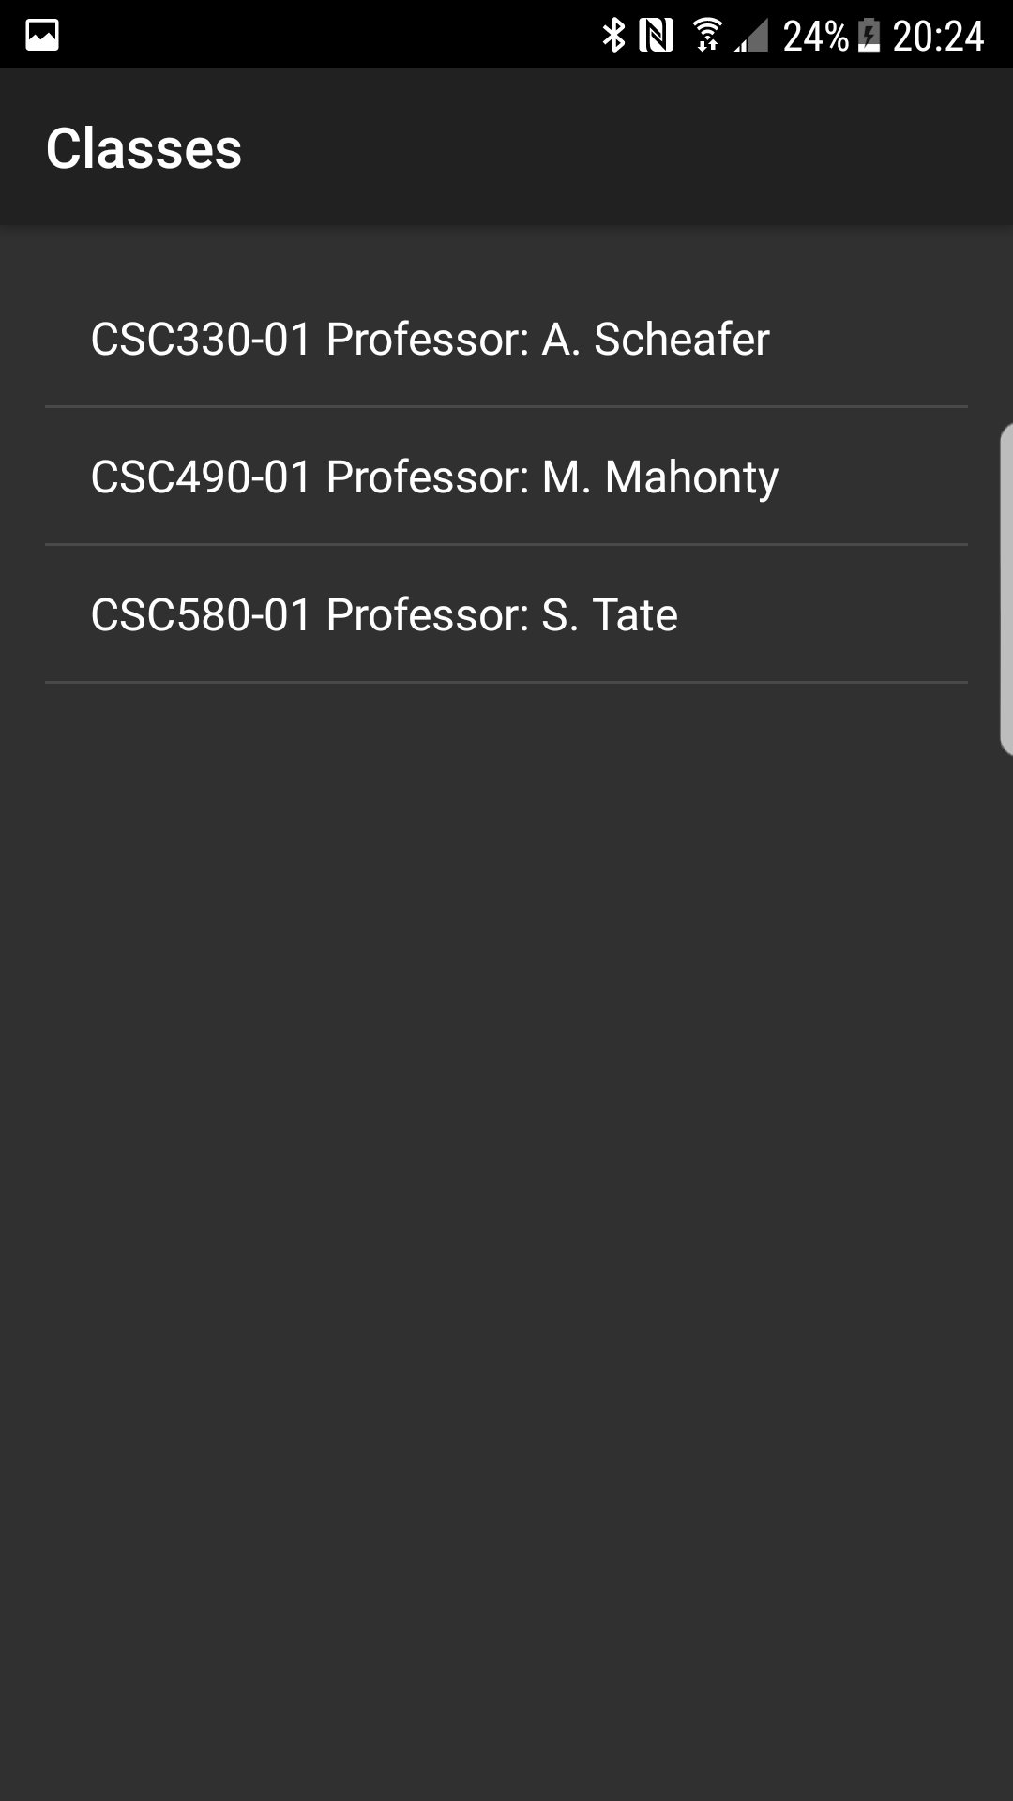
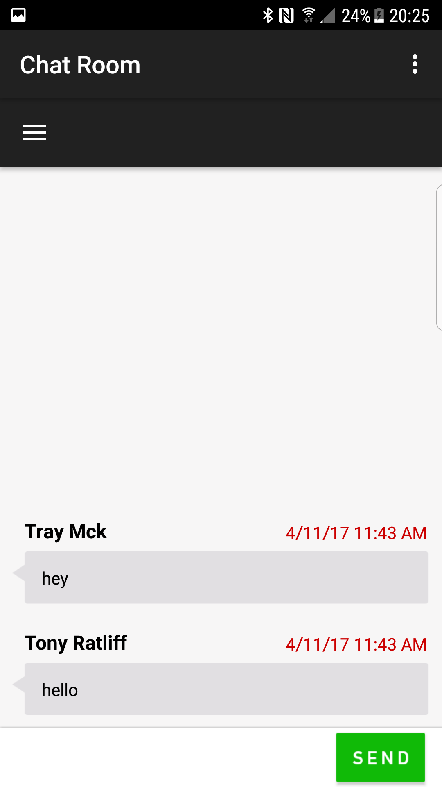

Slide 19
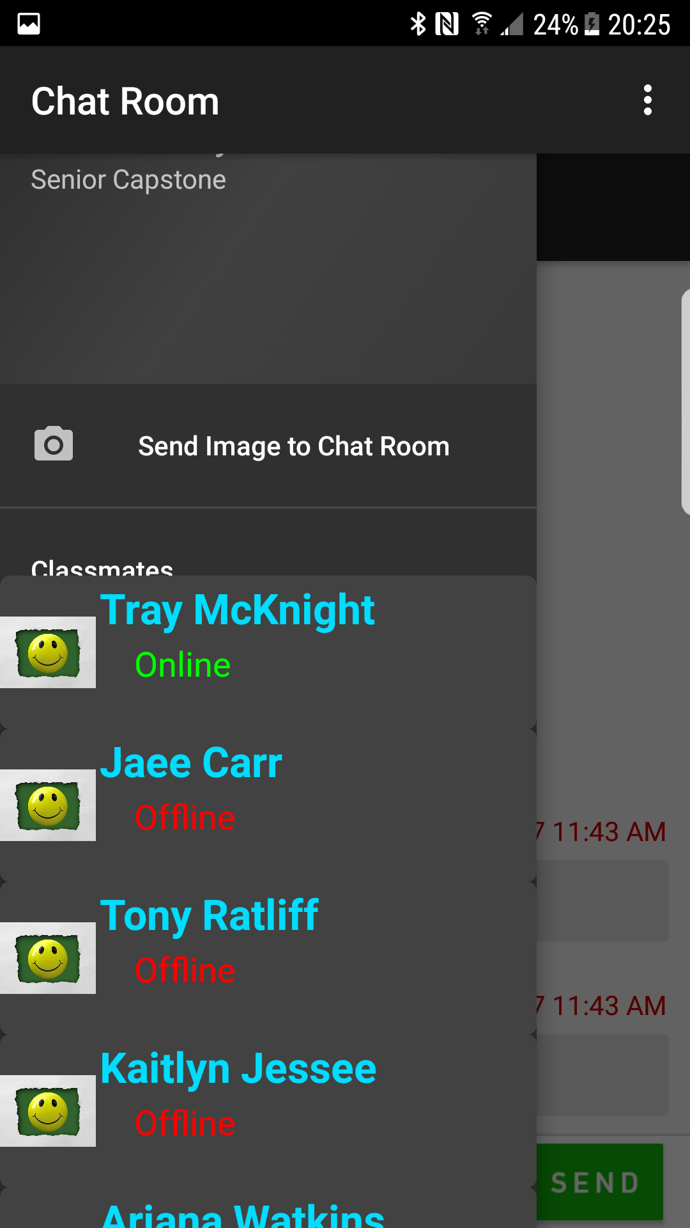

Slide 20
Future Efforts
More Intuitive UI

